Slide 1
DIVIDE AND CONQUER
SUBMITTED BY - ABHINAV SINGH
roll no. – 181210001
DIMPAL KATANIYA
roll no. - 181210022
CSE 2ND YEAR

Slide 2
Divide and conquer:
DIVIDE AND CONQUER
In divide and conquer approach, the problem in hand, is divided into smaller sub-problems and then each problem is solved independently.
When we keep on dividing the subproblems into even smaller sub-problems, we may eventually reach a stage where no more division is possible. Those "atomic" smallest possible sub-problem (fractions) are solved.
The solution of all sub-problems is finally merged in order to obtain the solution of an original problem.

Slide 3
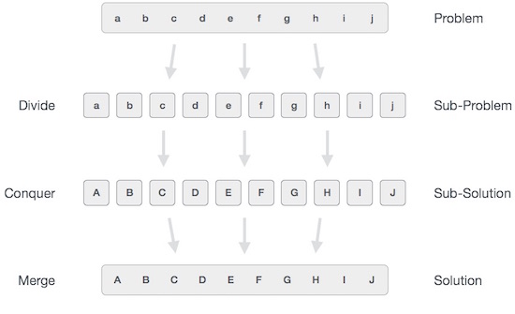
DIVIDE AND CONQUER

Slide 4
Examples:
DIVIDE AND CONQUER
The following computer algorithms are based on divide-and-conquer programming approach −
Binary Search
Merge Sort
Quick Sort
Closest pair (points)

Slide 5
(1.) Binary search:
DIVIDE AND CONQUER-BINARY SEARCH
Binary search can be performed on a sorted array.
In this approach, the index of an element x is determined if the element belongs to the list of elements.
If the array is unsorted, linear search is used to determine the position.

Slide 6
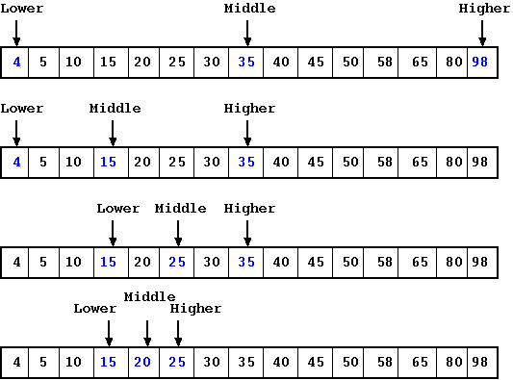
Example problem:
DIVIDE AND CONQUER-BINARY SEARCH
To find x = 20

Slide 7
Algorithm:
DIVIDE AND CONQUER-BINARY SEARCH
Binary-search(numbers[], l, r, x)
{
if l = r then
return 1
else
m = ⌊(l + r) / 2⌋
if x = number[m]
return m
else if x < numbers[m]
return Binary-search(numbers[], l, m, x)
else
return Binary-search(numbers[], m, r, x)
}

Slide 8
Time complexity:
DIVIDE AND CONQUER-BINARY SEARCH
Here
T(n)=0 ; if n=1
T(n) = T(n/2)+1 ;otherwise
So time complexity for binary search = O(logn)

Slide 9
2.MERGE SORT:
DIVIDE AND CONQUER-MERGE SORT
We have to sort a list of numbers.
In merge sort we use divide and conquer method to solve this problem.
split the list into two halves, recursively sort each half, and then merge the two sorted sub-lists.

Slide 10
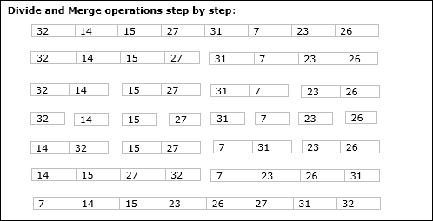
Example problem:
DIVIDE AND CONQUER-MERGE SORT
In the following example, Merge-Sort algorithm is shown step by step.
First, every iteration array is divided into two sub-arrays, until the sub-array contains only one element.
When these sub-arrays cannot be divided further, then merge operations are performed.

Slide 11
Algorithm:
DIVIDE AND CONQUER-MERGE SORT
Merge-sort(numbers[], l , r)
{
if l < r then
m = ⌊(l + r) / 2⌋
Merge-sort(numbers[], l, m);
Merge-sort(numbers[], m+1, r);
Merge(numbers[], l, r, m);
}

Slide 12
Algorithm:
DIVIDE AND CONQUER-MERGE SORT
Merge(numbers[], l , r, m)
{
n1 = m-l+1;
n2 = r-l;
Declare leftnums[1………n1+1] and rightnums[1…..n2+1] temporary arrays
for i = 1 to n1
leftnums[i] = numbers[p + i - 1]
for j = 1 to n2
rightnums[i] = numbers[q+j]
leftnums[n1+1] = ∞
rightnums[n2+1] = ∞
}

Slide 13
DIVIDE AND CONQUER-MERGE SORT
i=1
j=1
for k = l to r
if leftnums[i] <= rightnums[j]
numbers[k] = leftnums[i]
i++
else
numbers[k] = rightnums[j]
j++
if(i<=n1)
numbers[k++] = leftnums[i++]
else if(j<=n2)
numbers[k++] = rightnums[j++]

Slide 14
Time complexity:
DIVIDE AND CONQUER-MERGE SORT
From algorithm we can say that
T(n) = 2T(n/2) + O(n)
The above recurrence can be solved either using Recurrence Tree method or Master method
Time complexity of Merge Sort is O(nlogn) in all 3 cases (worst, average and best) as merge sort always divides the array into two halves and take linear time to merge two halves.

Slide 15
3.QUICK SORT:
DIVIDE AND CONQUER-QUICK SORT
Quick Sort is also a Divide and Conquer algorithm.
It picks an element as pivot and partitions the given array around the picked pivot.
There are many different versions of quick Sort that pick pivot in different ways.
1.Always pick first element as pivot.
2.Always pick last element as pivot.
3.Pick a random element as pivot.
4.Pick median as pivot.

Slide 16
The key process in quick Sort is partition().
DIVIDE AND CONQUER-QUICK SORT
Target of partitions is, given an array and an element x of array as pivot, put x at its correct position in sorted array and put all smaller elements (smaller than x) before x, and put all greater elements (greater than x) after x.
All this should be done in linear time.

Slide 17

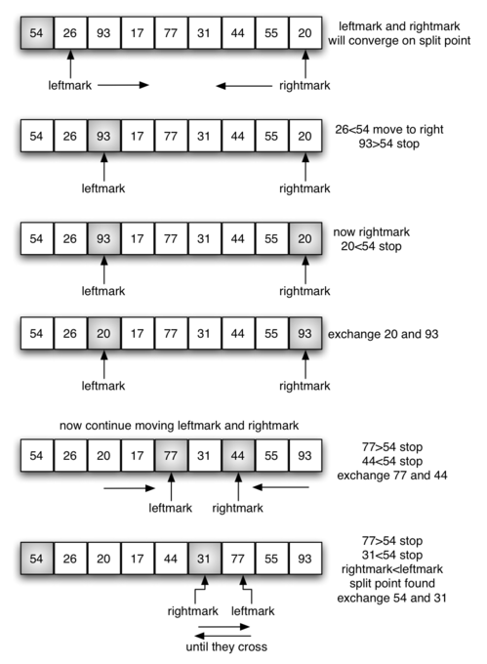
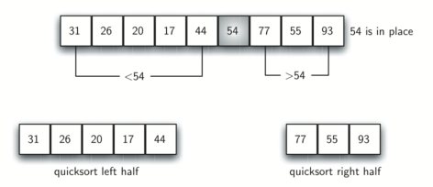
Example problem:
DIVIDE AND CONQUER-QUICK SORT

Slide 18
Algorithm:
DIVIDE AND CONQUER-QUICK SORT
quicksort(numbers[], low, high)
{
if(low<high)
{
pi = partition(numbers, low high);
quicksort(numbers, low, pi-1 );
quicksort(numbers, pi+1, high);
}
}

Slide 19
Algorithm:
DIVIDE AND CONQUER-QUICK SORT
partition(numbers[], low, high)
{
pivot = numbers[low];
i = low+1;
for j = low+1 to high{
if(numbers[j]<pivot)
{swap (numbers[i], numbers[j]);
i++;}
}
Swap(numbers[low], numbers[i-1]);
Return i-1;
}

Slide 20
Time complexity:
DIVIDE AND CONQUER-QUICK SORT
1. For best case:-
The best case occurs when the partition process always picks the middle element as pivot. Following is recurrence for best case.
Then
T(N) = 2T(n/2) + O(N)
So time complexity = O(nlogn)
2. For average case:-
We can get an idea of average case by considering the case when partition puts O(n/9) elements in one set and O(9n/10) elements in other set. Then
T(N) = T(n/10) + T(9n/10)+O(N)
So time complexity = O(nlogn)

Slide 21
3. For worst case:-
DIVIDE AND CONQUER-QUICK SORT
The worst case occurs when the partition process always picks greatest or smallest element as pivot.
Then
T(n) = T(n-1) + O(n)
So time complexity = O(n^2)

